Slide 1
Guardian-Call
Adult and disabled care taking device
Tech Wizards

Slide 2
Overview
Problem identification
Solution
Product architecture
Technology stack identification
PCB design
Enclosure design
Mobile app
Specification
Budget
Marketing & Sales
Task Allocation

Slide 3

Problem identification
Most of the elderly individuals struggle with daily activities due to limited mobility, memory loss and communication difficulties. This results in a weakened sense of time and missed medications and difficulty to seek assistance during an emergency.

Slide 4
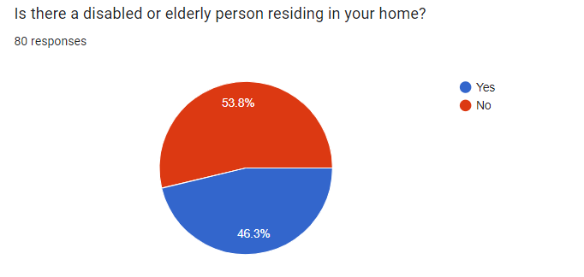
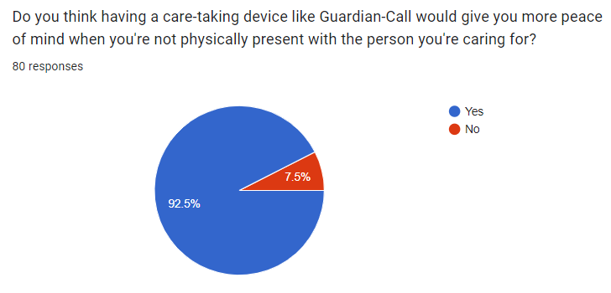
Problem validation
To validate these problems an extensive survey was conducted and we were able to gather data from around 80 individuals through an online survey using google forms. Key focus areas of our bedside companion was identified through the survey
Almost 54% of the respondents had an elderly or a disabled person at their households to whom they provide regular care.
After giving a product specification,92% have responded by mentioning that having such a product would ease the tasks of the caretakers, when they are not physically present with the bedridden person

Slide 5
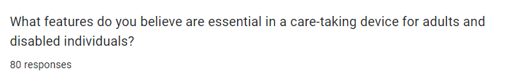
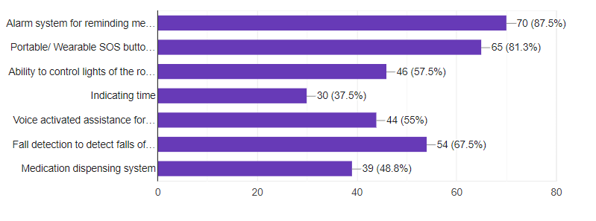
According to the survey, this is how the respondents assumed what feature will be most beneficial to them

Slide 6
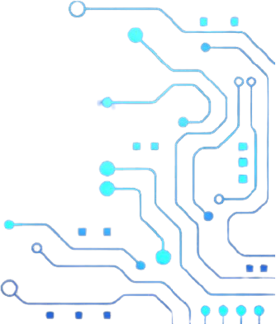
Solution
We introduce Guardian-Call, a multi tasking bedside companion machine to help the bed-ridden individuals. Main functions of this device are
SOS button to call for immediate assistance
Alarm and time system for reminding medication
Capability of maintaining communication between multiple caretakers and multiple patients.
Our solution requires a local wifi network to connect to the internet and send/receive data with a mobile app installed on the care takers’ smart phone.

Slide 7
Technical feasibility
As per the results of our second prototype attempt, we have concluded that the ESP32 SoC chip is more than capable enough to meet our requirements as it has,
Inbuilt dual mode wifi interface- to connect to a local network while maintaining a peer-to-peer connection with another ESP32.
Multiple SPI interfaces- to drive a 2.8“ display and a touch screen.
520 KB SRAM and 4MB flash memory to meet our requirements.
Deep sleep mode with low power consumption.
Also all the required components are available locally and free tiers of SaaS products (like firebase) is sufficient for requirments of our product.

Slide 8

Product Architecture
Externel wifi internet access (Router)
Main unit
TFT LCD touch display
User interface
ESP-WROOM-32
connecting to wifi
Wearable button 01
ESP-01S
Clock interface
Buttons connect interface
ESP 01S
push button
Firebase Database
Device ID
Alarm/message display
Alarm Data
Buzzer
Wearable button 02
Button data
ESP-01S
Secret Key
User
push button
Mobile Application
(Android studio/java
Wifi credentials,
connecting buttons
Alarm/messages

Slide 9
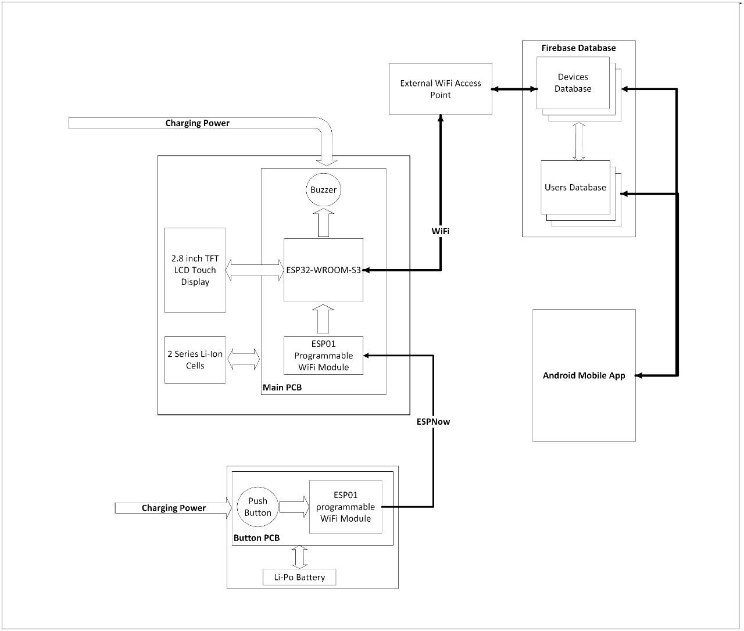
Block Diagram

Slide 10
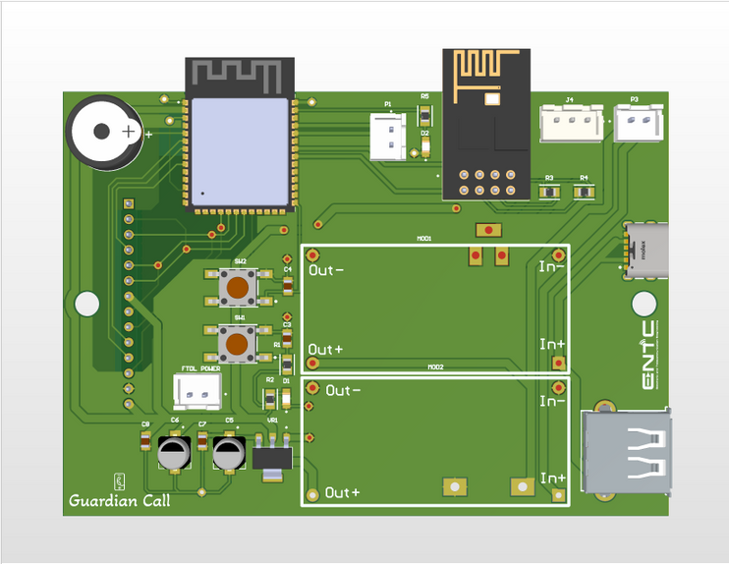
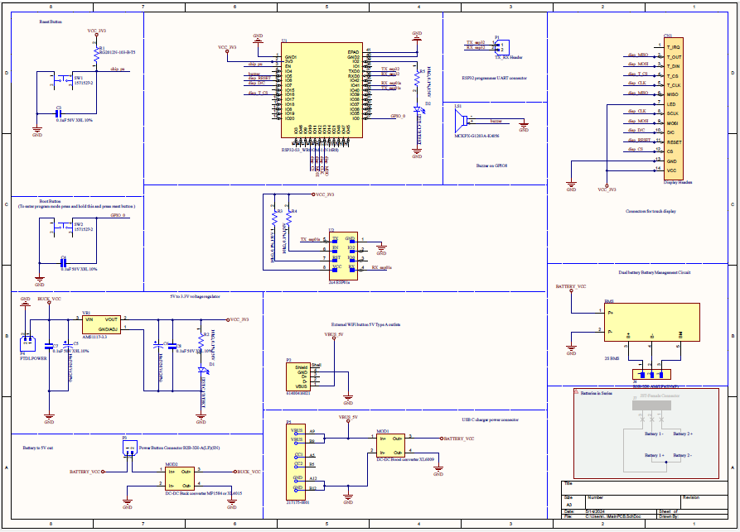
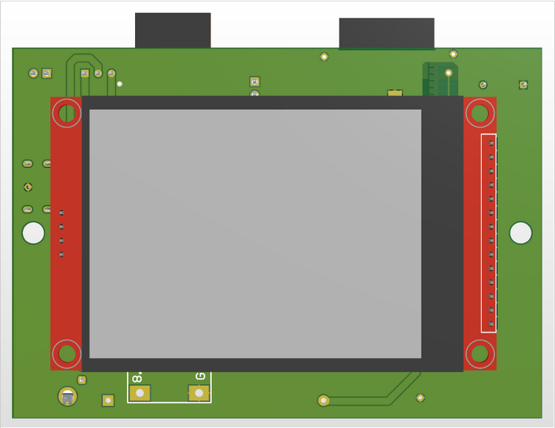
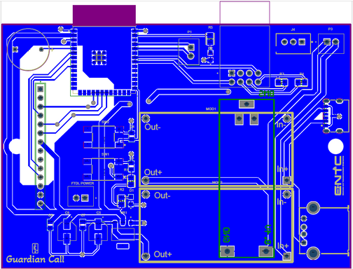
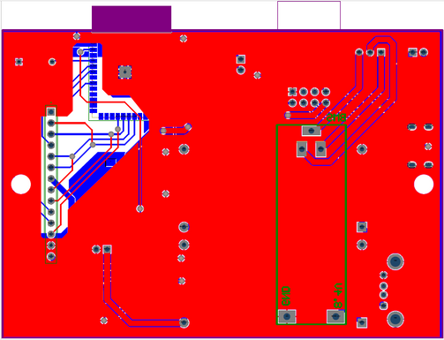
PCB Design - Main Unit

Slide 11
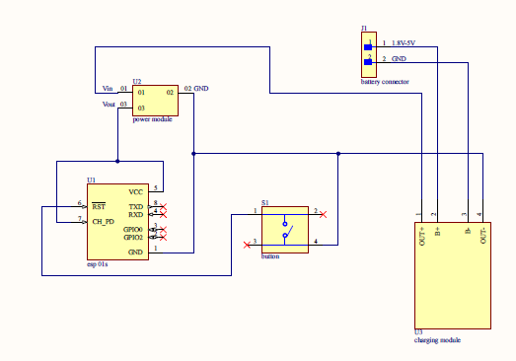
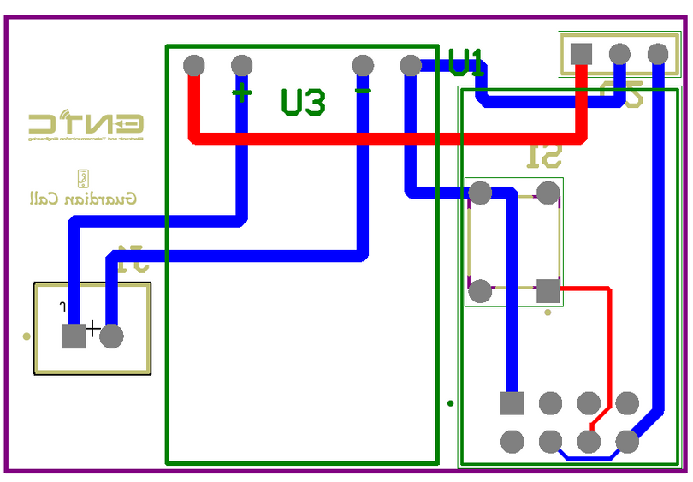
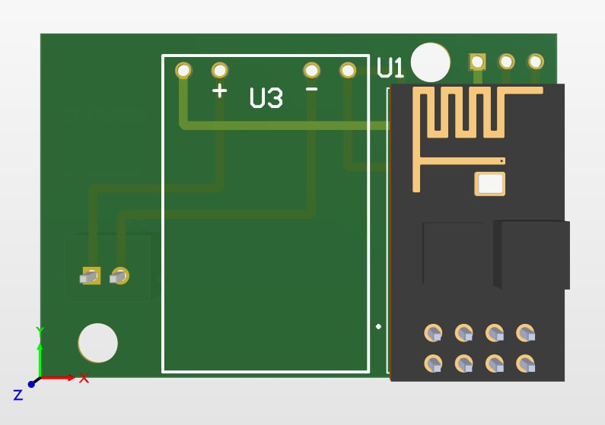
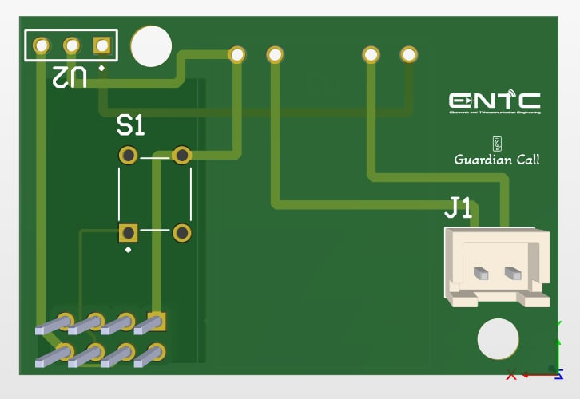
PCB Design - Button

Slide 12


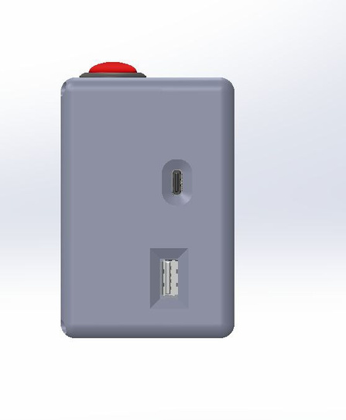
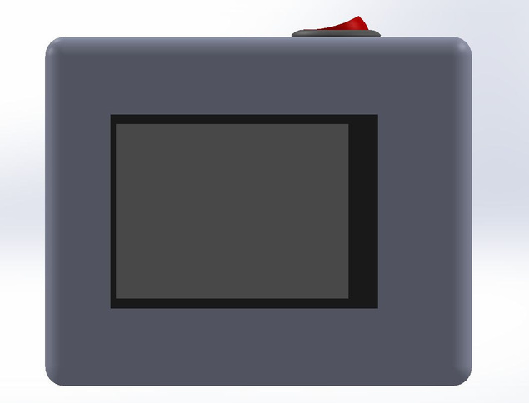
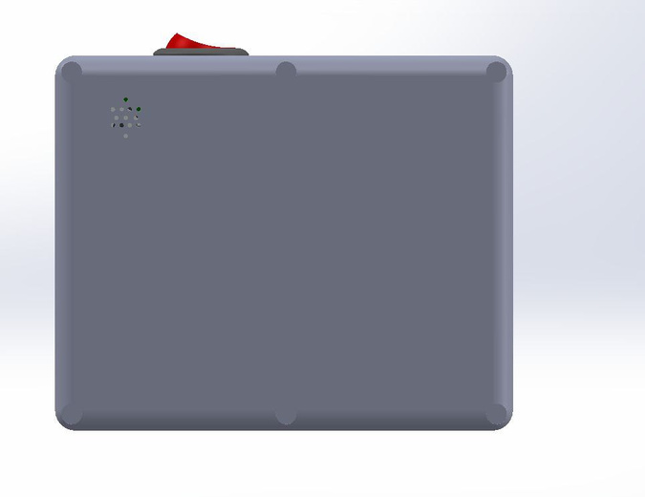
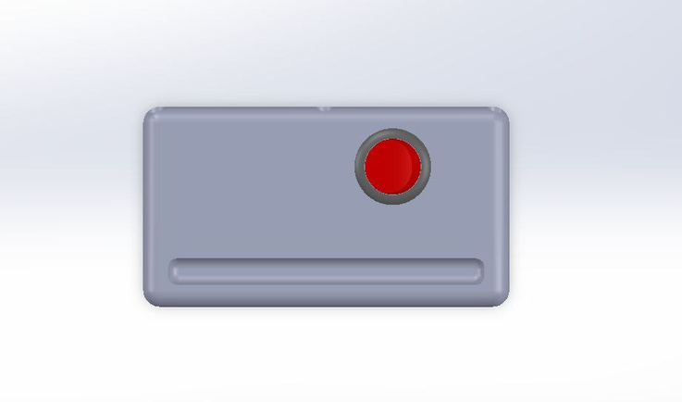
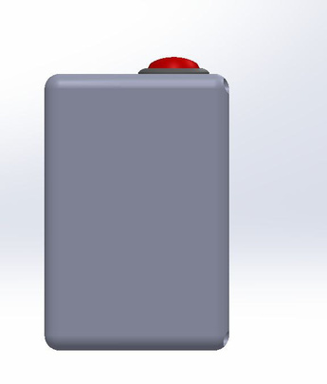
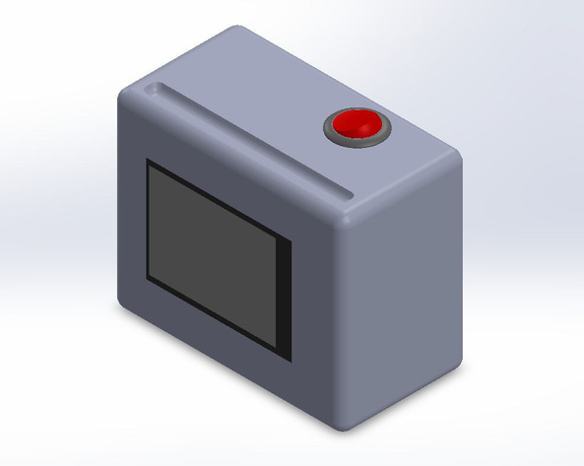
Enclosure design - Main Unit
Front view
Back view
Left side view
Top view
Right side view

Slide 13
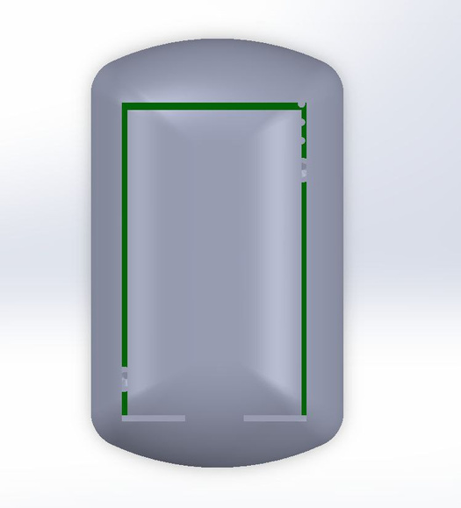
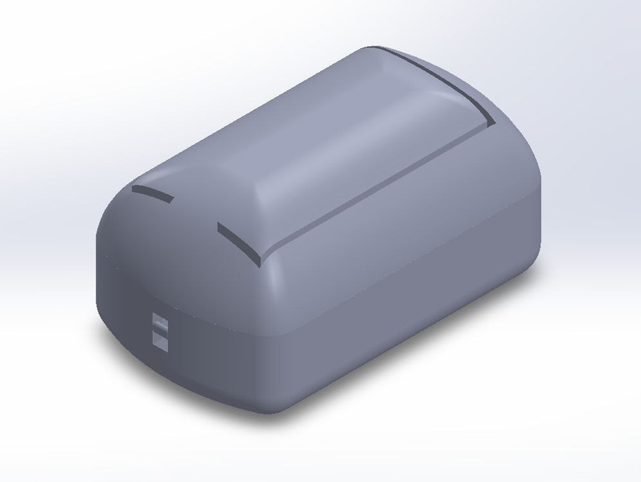
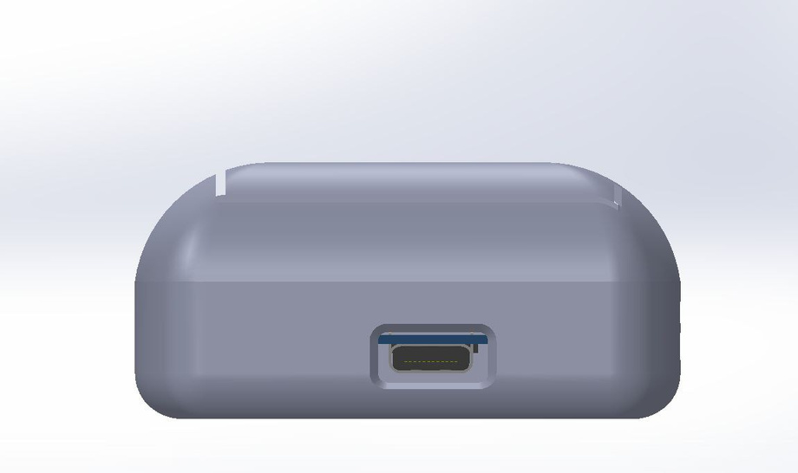
Enclosure design - Button
Top view
Side view

Slide 14
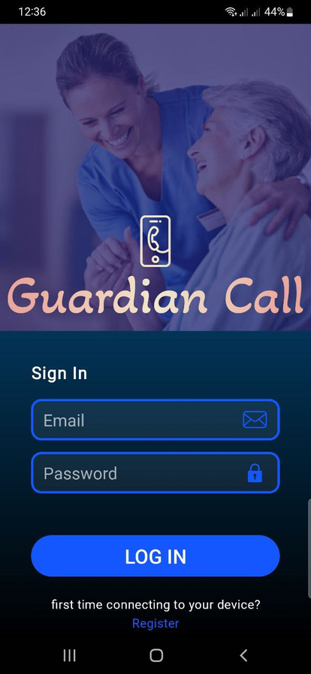
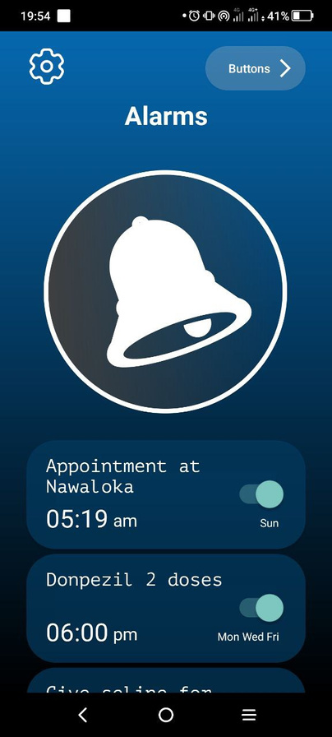
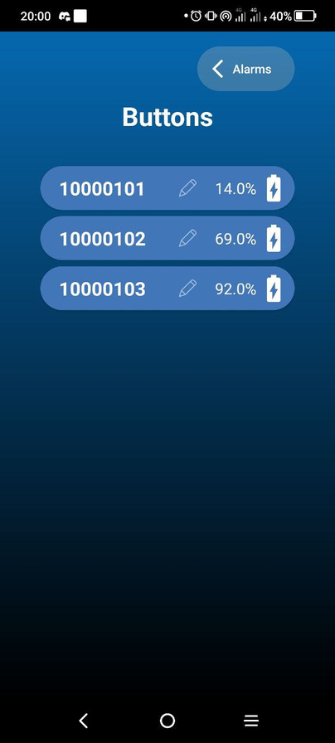
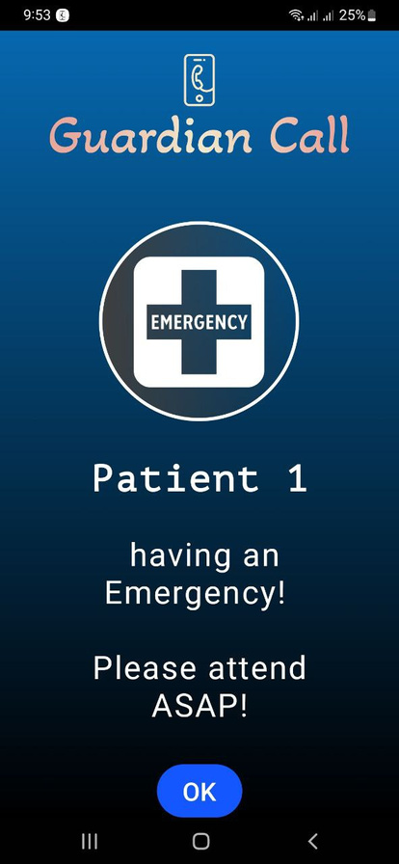
Mobile app
Current Capabilities :
Set alarms , Rings in Emergancy , Battery Level indication of button
Future Modifications :
Text to Voice features. Multiple buttons and Multi puropse buttons.

Slide 15
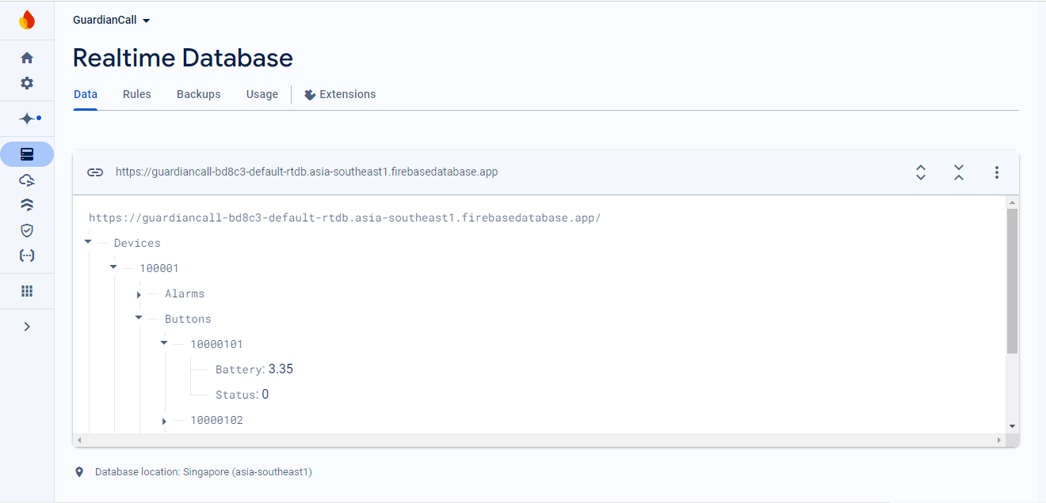
Firebase real-time database

Slide 16
Specifications
 | Main Unit | Button
Weight | 290 g | 25 g
Height | 90 mm | 28 mm
Width | 60 mm | 35mm
Length | 110 mm | 60 mm
Charging Time | - | 12 min
Battery Life | 18 h | 20 days
 | Main Unit | Button
Battery Capacity | 3600mAh | 150mAh
Operating Voltage | 8.4-6.0 V | 4.2-3.0 V
Operating Current | 200 mA | Button Press - 140.6 mA (1.1 Seconds) Deep Sleep - 300uA
Power Consumption | 1.68 W | 1.3 mW
Range

Slide 17
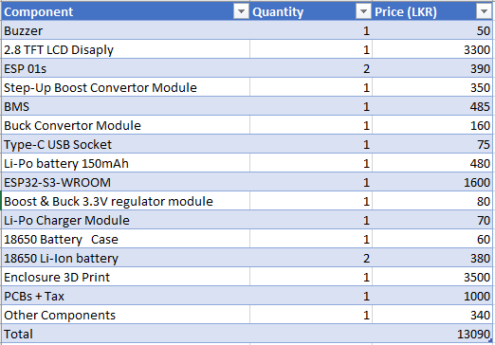
Budget

Slide 18
Marketing & Sales
Collaborations: Partner with private hospitals to demonstrate and recommend the device.
Social Media Marketing: Target campaigns toward families caring for elderly members, showcasing the device’s benefits.
Live Demos: Offer demonstrations at hospitals and senior living communities.
Customer Stories: Share testimonials and case studies on social media to build trust and highlight effectiveness.

Slide 19
Task Allocation
Gunasekara VGV 220193M | Gunathilaka KL 220197E | Ilukkumbura IMEIB 220235V | Priyanjana TPIM 220495P
Research survey | PCB design of Main unit | 3D enclosure design (Main device , Button) | PCB design of the Button
App development | App development | App development | App development
Documentation | Programming micro-controller of main device | Assembling | Programming micro-controller of main device
Testing | Soldering | Documentation | Soldering

Slide 20
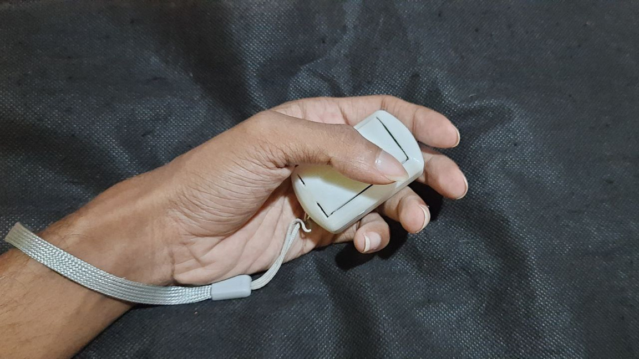
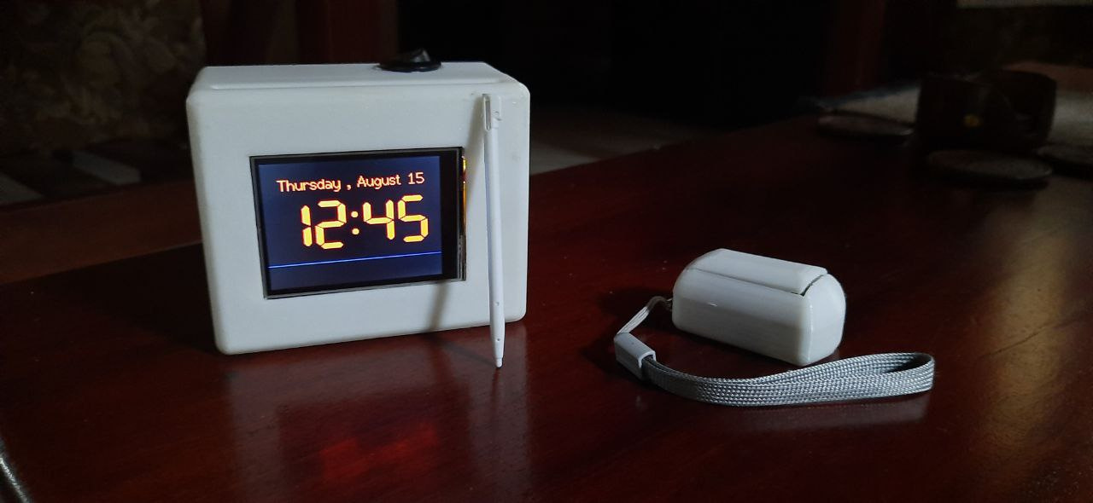
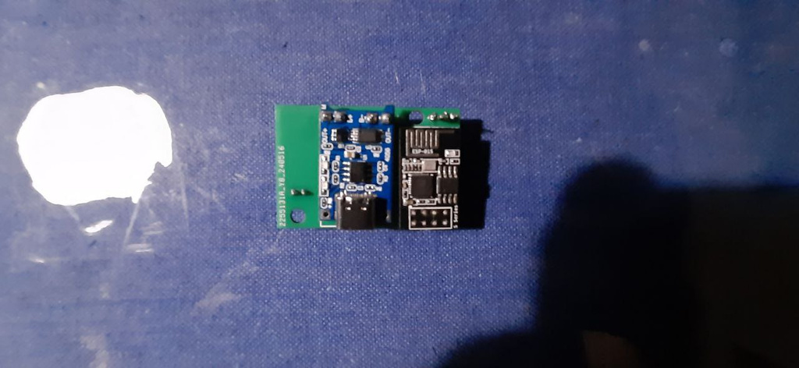
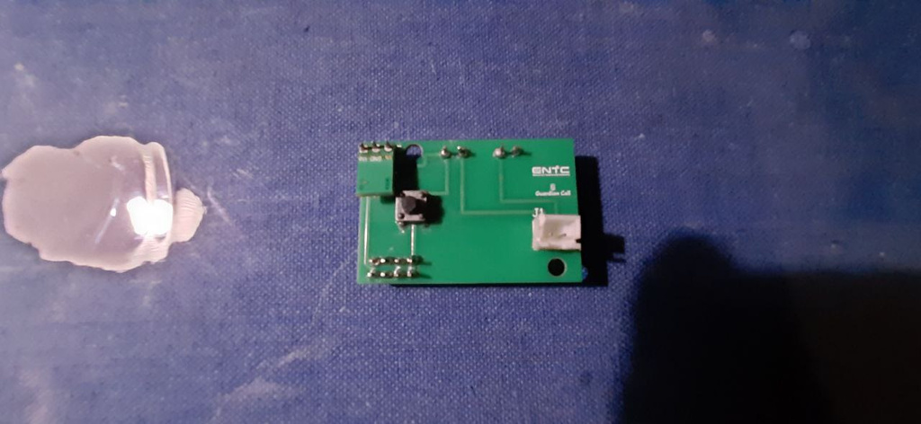
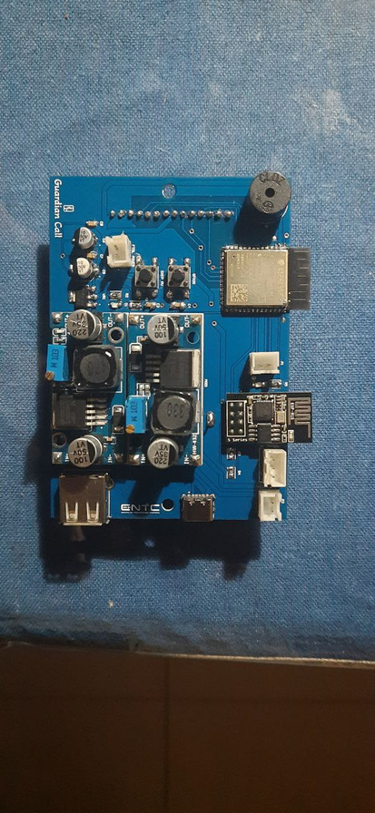
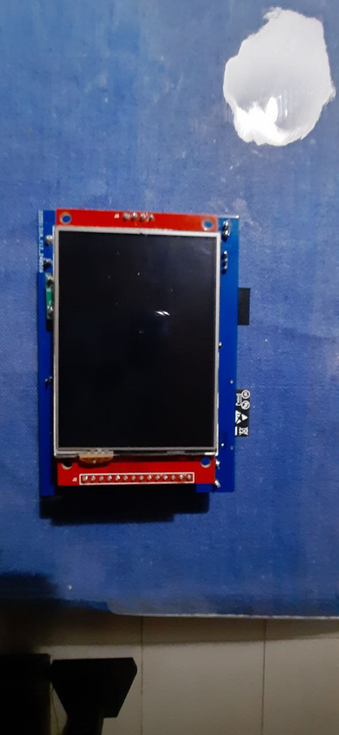
Actual Device

Slide 21
Thank You

